Slide 1
MACHINE LEARNING · REGRESSION PROJECT
Cricket Performance Player Prediction
Predicting cricket player performance from previous match records using Ridge, Lasso and Elastic Net regression.
TEAM
UNDER THE GUIDANCE OF
Member 1
Roll No: 2520030509 | Name: M.V.L.Samhita
Assistant Professor | CSE
Mr. Shaik Asif
Member 2
Roll No: 2520030499 | Name: Sahithi Gotte
01
Notes:
Title slide. Replace member names, roll numbers and faculty name before submission.

Slide 2
THE TASK
Problem Statement
REGRESSION TASK
TARGET VARIABLE
Estimate how many runs a batter will score in an innings from their recent form and match involvement — framed as a supervised regression problem on continuous output.
runs_x — runs scored in a single innings. Range 0–329, mean 23.8, standard deviation 28.6 across 46,263 innings.
WHY MANUAL ANALYSIS FAILS
WHY IT MATTERS
Performance depends on balls faced, boundaries, batting order, format, opposition and recent form at once. Weighing these by eye is subjective and does not scale across 946 players.
A reliable estimate supports team selection, fantasy scoring and workload planning — and shows which performance factors actually carry predictive signal.
2
Models Compared
4
Evaluation Metrics
Ridge · Lasso ·
MAE · MSE · RMSE · R²
02
Notes:
The target is innings runs. Three regularized linear models are compared on the same feature set.

Slide 3
SCOPE
Project Objectives
Analyse historical records
Identify key drivers
01
Explore 46,300 batting innings across T20, ODI and Test formats.
02
Measure which involvement and form variables correlate with runs.
Clean & preprocess
Engineer form features
03
Handle missing values, verify types, scale numeric predictors.
04
Create features based on a player's previous performances, such as career averages and recent-form averages.
Build regression models
Evaluate
05
Train Ridge, Lasso and Elastic Net on an identical pipeline.
06
Score every model on MAE, MSE, RMSE and R²..
03
Notes:
Eight objectives spanning data preparation through prediction.

Slide 4
Motivation
01
Form Changes
02
One statistic is not enough
A career average built over 10 years cannot notice that a player has failed in his last five innings. Recent form and career form are different pieces of evidence.
Runs, strike rate, boundaries, balls faced and batting position each describe a different part of a batter. Selection debates usually quote only one of them.
03
Records contain patterns
04
ML combines predictors
Regression can weigh all sixteen historical signals together, instead of a human eyeballing one column at a time.
Across 46,300 innings the same signals repeat: batters who face more balls and hit more fours historically also score more in the next innings.
“Instead of simply asking whether a player is good, the project attempts to quantitatively estimate player performance using evidence from previous records.”
03
Notes:
Eight objectives spanning data preparation through prediction.

Slide 5
DATA SOURCE
Dataset Description
RAW INNINGS RECORDS
PLAYERS MODELLED
SEASONS COVERED
46,300
946
2004–2021
SOURCE FILES
TARGET VARIABLE
bat.csv · ball.csv · match.csv
runs_x — innings runs
bat.csv is the modelling table: one row per batter per innings, joined to match-level context. ball.csv holds bowling figures and match.csv holds innings totals, run rates and team identifiers.
TARGET VARIABLE — runs_x
Innings-level batting performance
0–329 runs per innings
Mean: 23.8 runs
Median: 13 runs
Used as the continuous target for regression
runs_x — runs scored (target)
balls — deliveries faced
fours / sixes — boundaries hit
order — position in batting line-up
strike_rate — scoring efficiency
matchtype — T20 / ODI / Test
over, run_rate — innings context
start_date, player_id — form tracking keys
04
Notes:
bat.csv is the primary table; 946 players survive the minimum-innings filter.

Slide 6
STRUCTURE
Dataset Snapshot
NUMERICAL FEATURES
CATEGORICAL FEATURES
DATE / KEY FEATURES
runs_x
balls
strike_rate
fours
sixes
order
over
run_rate
fall_of_wicket_over
name_x — player
playing_role
matchtype
how_out
title — innings
team_id
opp_team_id
start_date
player_id
match_id
scorecard_id
series_id
match_number
This slide shows the different types of variables in our dataset. We have numerical features, categorical features, and date or identifier columns. Categorical variables such as match type are encoded so that the machine learning models can process them. Identifiers are mainly used for tracking and grouping rather than prediction
05
Notes:
T20 dominates the record count; format is one-hot encoded rather than filtered out.

Slide 7
PREPARATION
Data Cleaning & Preprocessing
Problem | Observation in our data | Handling
Missing values | playing_role 1,543, match_number 635, matchtype 37, name_y 13, how_out 9. ball.csv: fours/sixes/zeros 36,134 (99.96%). match.csv: match_number 75, name 2, matchtype 4 | Drop near-empty columns; label missing matchtype as “unknown” rather than guessing
Duplicate records | 0 fully duplicated rows in all three files. 0 duplicates on (player_id, scorecard_id) — each player appears once per innings | Nothing to remove; uniqueness confirms one row = one innings
Data types | start_date read as text; match_number stored as float; index column imported as “Unnamed: 0” | Convert start_date to datetime (essential for chronological ordering); drop the stray index column
Identifier columns | player_id, match_id, scorecard_id, series_id, team_id, opp_team_id, match_detail_id are arbitrary numbers | Used only for grouping and joining — never as numeric predictors
Invalid values | 828 innings with balls = 0 (all have 0 runs and SR 0 — valid “out without facing”). strike_rate reproduces runs/balls×100 exactly in every checkable row; boundary runs never exceed total runs. how_out contains HTML fragments (&dagger;, &amp;) | No impossible statistics found. Keep 0-ball innings; decode HTML entities in how_out
06
Notes:
Excluding same-innings strike rate is the key decision — without it the target is trivially recoverable.

Slide 8
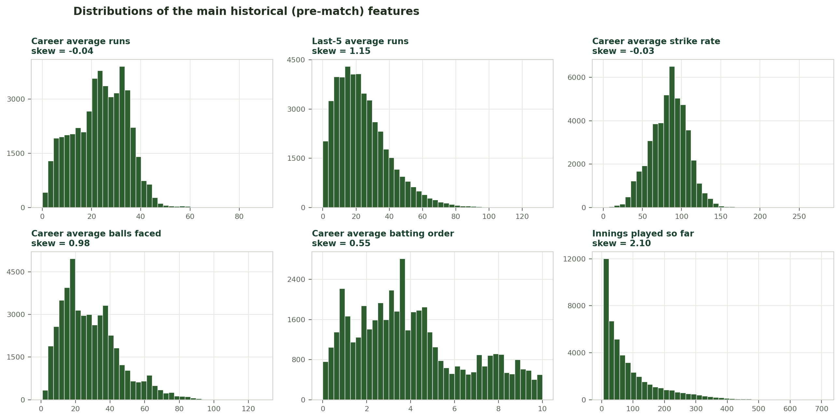
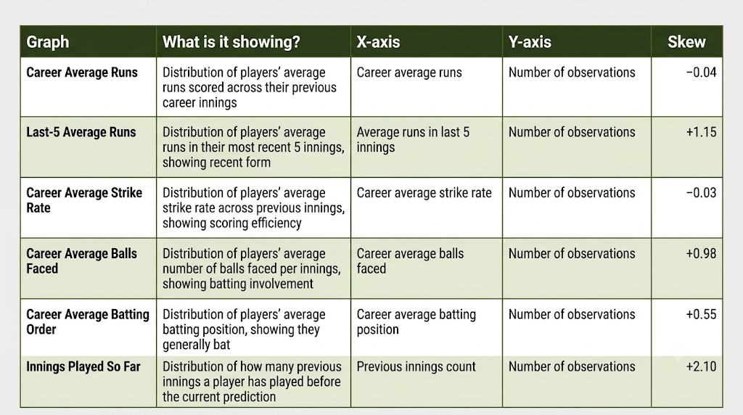
PREPARATION
EDA — Feature Distributions
Why this matters before modelling: Ridge and Lasso penalise the size of the coefficients. A feature measured in the hundreds needs a small coefficient and a feature measured in units needs a large one, so an unscaled penalty punishes the small-scale features unfairly. → StandardScaler first, then Ridge / Lasso.
06
Notes:
Excluding same-innings strike rate is the key decision — without it the target is trivially recoverable.

Slide 9
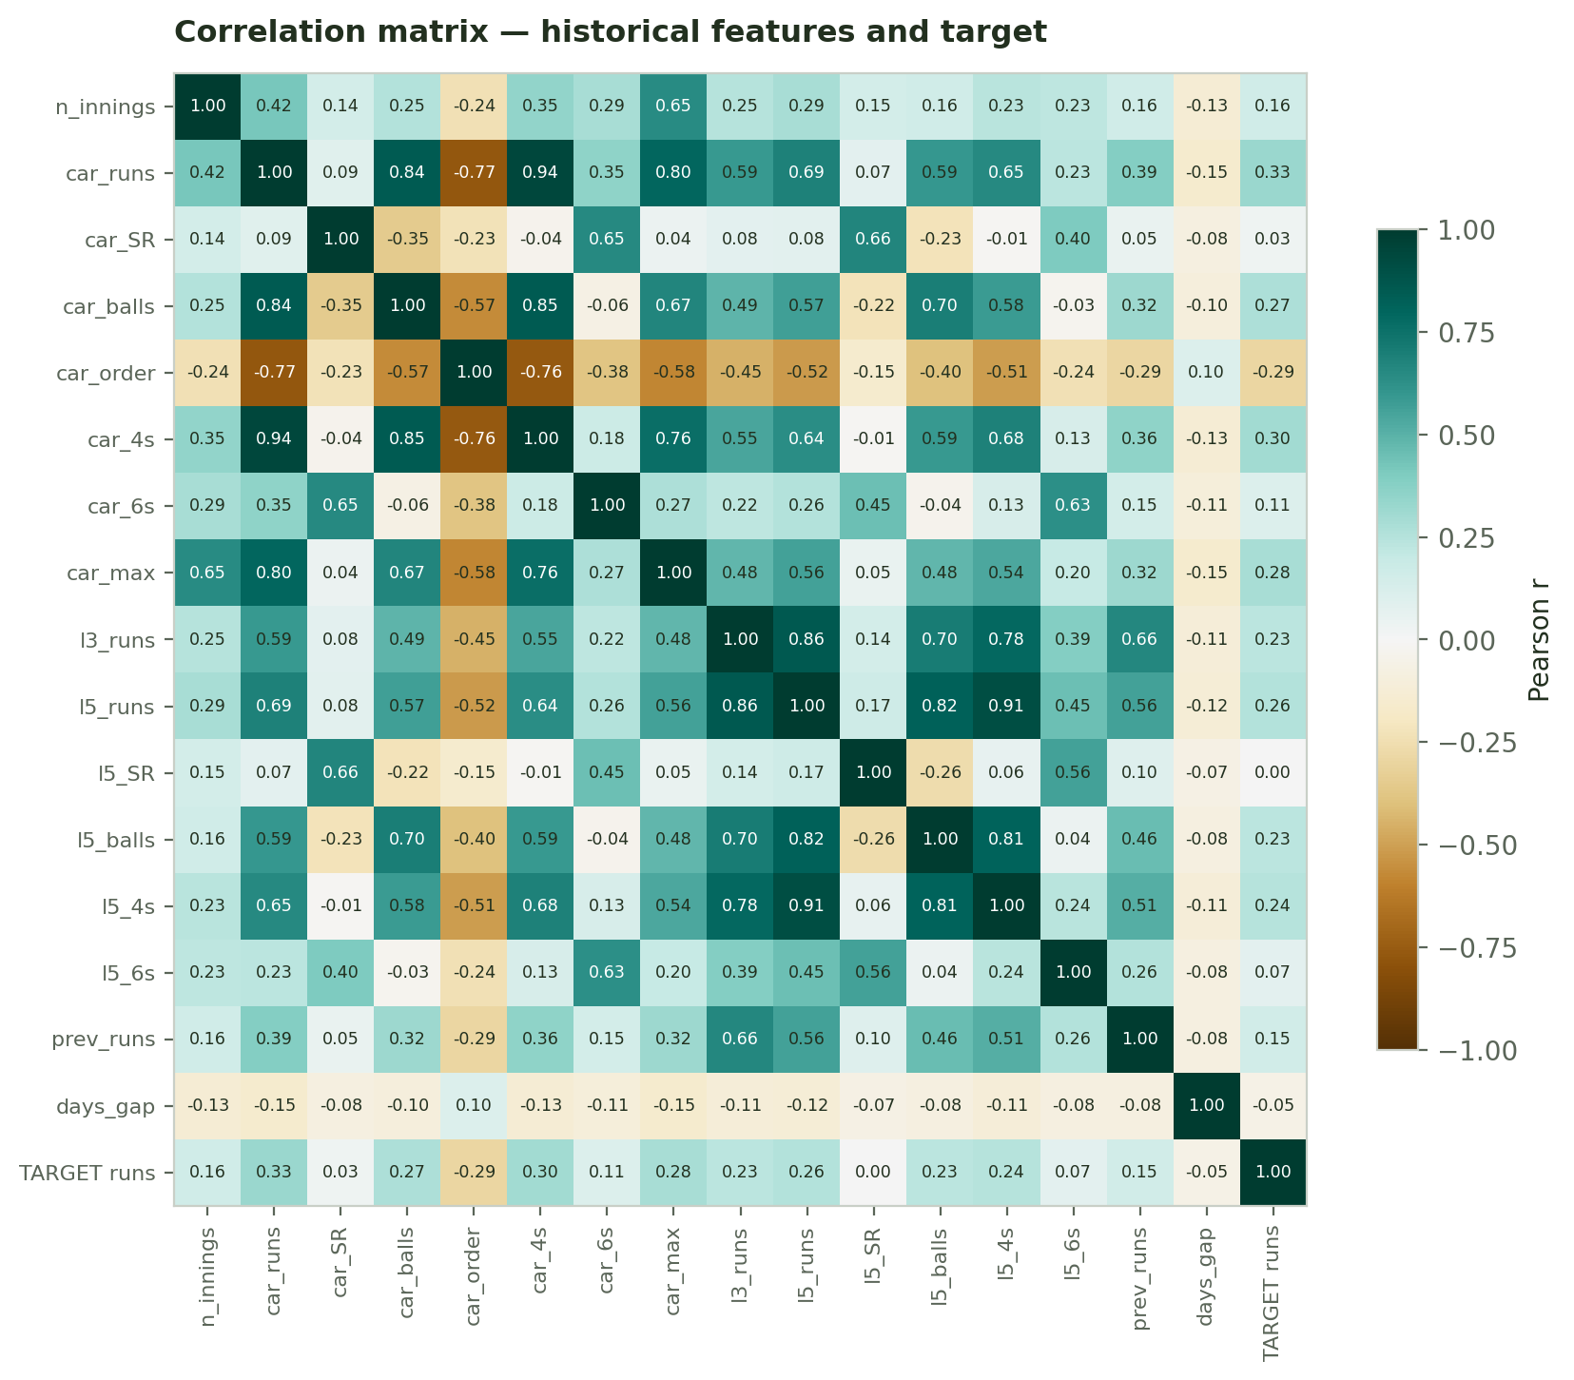
Correlation Analysis & Multicollinearity
Strongly correlated predictor pairs
Pair | r
career_avg_runs ↔ career_avg_fours | +0.94
last5_avg_runs ↔ last5_avg_fours | +0.91
last3_avg_runs ↔ last5_avg_runs | +0.86
career_avg_balls ↔ career_avg_fours | +0.85
career_avg_runs ↔ career_avg_balls | +0.84
career_avg_runs ↔ career_max_runs | +0.80
career_avg_runs ↔ career_avg_order | −0.77
Why this decides the algorithm
Correlated predictors (r up to 0.94)
Ordinary least squares cannot tell them apart
Coefficients become large, unstable, sign-flipping
Add a penalty on coefficient size
06
Notes:
Excluding same-innings strike rate is the key decision — without it the target is trivially recoverable.

Slide 10
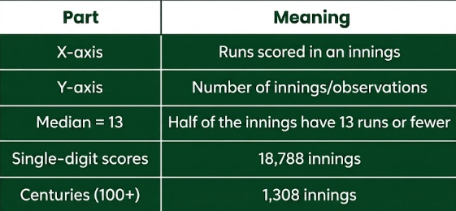
EXPLORATORY ANALYSIS
EDA — Distribution of Runs
runs — half of all innings finish at 13 runs or fewer.
07
Notes:
Right skew explains the RMSE-vs-MAE gap seen later in evaluation.

Slide 11
MODEL 01
Ridge Regression
L2 REGULARIZATION
Penalises the sum of squared coefficients
alpha = 1.0
The loss becomes RSS + α · Σβ². Raising α shrinks every weight toward zero without ever reaching it, trading a little bias for a large reduction in variance.
RSS + α · Σ|β| ^ 2
Ridge Regression is Linear Regression with L2 regularization. Since our features have multicollinearity, Ridge adds a penalty based on the squared coefficients. This shrinks large coefficients, improves model stability, and helps control overfitting. In our implementation, alpha is set to 1.0, and the numerical predictors are scaled before training.
Handles multicollinearity
Stabilises coefficients
Balls, fours and sixes are strongly correlated; Ridge distributes weight across them instead of picking arbitrarily.
Small changes in the training sample no longer swing the fitted weights.
Keeps every feature
Controls overfitting
Nothing is dropped, so weak-but-real signals such as run rate still contribute.
Model complexity is limited without reducing the feature count.
11
Notes:
Ridge is the natural fit given how correlated the involvement features are.

Slide 12
MODELS 02 AND 03
Lasso Regression
LASSO — L1 REGULARIZATION
RSS + α · Σ|β|
The absolute-value penalty can force coefficients to exactly zero, so Lasso selects features as it fits. Configured with alpha = 0.01.
ADVANTAGES & LIMITS
ADVANTAGES & LIMITS
Removes uninformative predictors outright
Produces a sparser, easier-to-explain model
Identifies which performance factors truly matter
Can behave unstably when features are highly correlated
Selects features like Lasso, groups them like Ridge
Keeps correlated predictors together rather than dropping one
Two hyperparameters allow finer control of the trade-off
Best all-round choice when predictors overlap in meaning
LARGEST STANDARDISED COEFFICIENTS (RIDGE)
+13.81
+12.49
+8.06
+1.17
-1.00
Fours
Balls faced
Sixes
Career avg
Overs
12
Notes:
At alpha = 0.01 neither Lasso nor Elastic Net zeroes a feature — the penalty is too light relative to the signal.

Slide 13
HOW MODELS ARE JUDGED
Model Evaluation Metrics
MAE
MSE
RMSE
R²
Mean Absolute Error
Mean Squared Error
Root Mean Squared Error
R SQUARED
Average absolute gap between predicted and actual runs, in runs. Robust to the century tail.
Averages squared errors, so a single badly missed big innings costs far more than several small misses.
Square root of MSE, returning the error to the original unit — runs — so it can be read directly.
Share of the variance in innings runs the model explains. 1.0 is a perfect fit, 0 is no better than the mean.
LOWER IS BETTER
LOWER IS BETTER
LOWER IS BETTER
HIGHER IS BETTER
13
Notes:
MAE and RMSE are both in runs, so they are directly interpretable.

Slide 14
PIPELINE
Proposed Methodology
Historical
Records
›
Data
Cleaning
›
Feature
Engineering
›
Exploratory
Analysis
›
Scaling &
Encoding
›
Train / Test
Split
L2 PENALTY
L1 PENALTY
Ridge Regression
Lasso Regression
Shrinks correlated coefficients together without removing any feature.
Drives weak coefficients to exactly zero, performing feature selection.
Model Training
›
Metric Evaluation
›
Model Comparison
›
Best Model Selected
10
Notes:
All three models share one preprocessing pipeline so the comparison is fair.

Slide 15
SUMMARY
Conclusion
WHAT WAS BUILT
WHAT WAS LEARNED
A working regression system for player performance
Regularization is a safeguard, not a boost here
Historical match records were cleaned, enriched with leakage-free form features, and used to train Ridge, Lasso and Elastic Net models that estimate innings runs on unseen data with an average error of roughly four and a half runs.
On a wide, clean dataset with far more rows than predictors, L1 and L2 penalties barely alter the fit. Their value would appear with more features, smaller samples, or heavier collinearity.
FACTORS FOUND TO DRIVE PERFORMANCE
Balls faced
Fours & sixes
Batting order
Opportunity
Scoring power
Role proxy
Career average
Recent form
Match format
Baseline skill
Short-term trend
Scoring context
18
Notes:
Close on the two takeaways: the system works, and regularization mattered less than expected.

Slide 16
Thank You
20
Notes:
Closing slide.

